Slide 1
HHS P-Tech Professional Development
Failure Preventions & Parent Conferences

Slide 2
EP#1
Think about the students in your classes who are not successful; students who are failing, falling behind, etc. explain why you believe they are failing your class? (be ready to share)

Slide 3
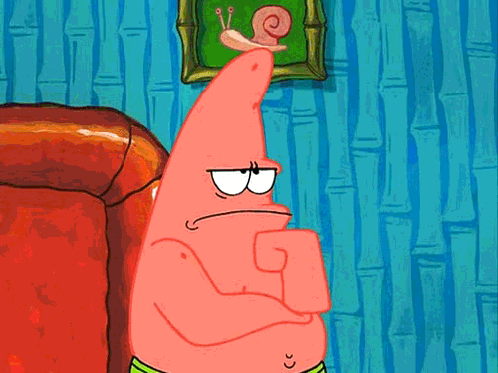
explain why you believe they are failing your class?
eP#2

Slide 4
Learning Goal:
I am learning how to prevent student failures.

Slide 5
Success Criteria
-I can explain the importance of documentation interventions prior to student failure.
I can explain the usefulness of parent teacher conferences.
I can implement one best practice by next week.

Slide 6
Documentation
20+ = Failure rate in any class requires documentation
List of Required Documentation

Slide 7
Teacher Best Practices
EP
-Updating Grades Weekly
-Posting Grades in/out of classrooms
-Provide extra credit if possible
-Provide clear due dates
-Use student planners
-Check ins with failing students

Slide 8
Parent Conferences - Tuesday, Sept. 14th
* Postponed until further notice
-Follow up with calls home to let parents know students need tutoring, help, etc.

Slide 9
EP
Parent Conference Tips
Start with something positive
Grades and attendance
Pull up and share screen with parents if necessary
Address any concerns with parents regarding participation, attitude, motivation, etc.

Slide 10
Thanks!
Any questions?
You can find me at:
Efrem.Pierce@fortbendisd.com
281-634-5279 or 281-634-2585

